Slide 1
Fuel Measurement Methodologies
Pyregence Technical Advisory Committee Meeting
Fall 2022
Daniel Foster
Notes:
Pyregence background
This talk: TAC meeting
Feedback on:
Balance of new / old material
Level of detail
Content ordering

Slide 2
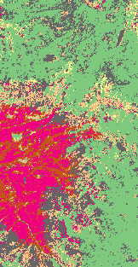
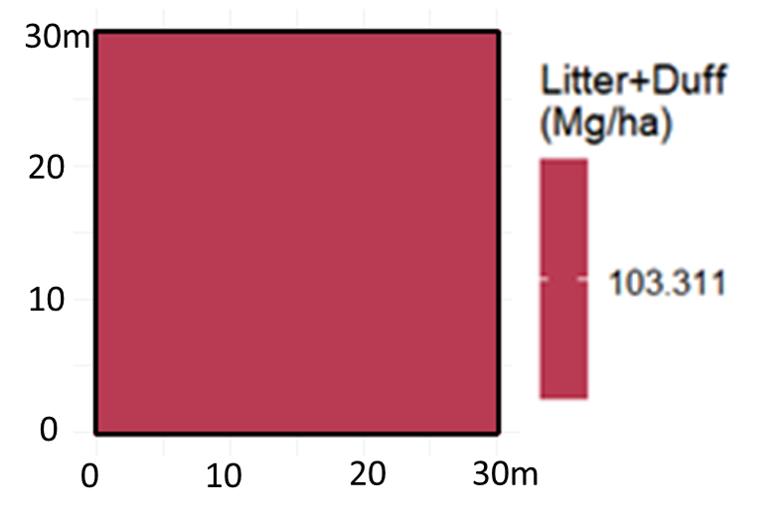
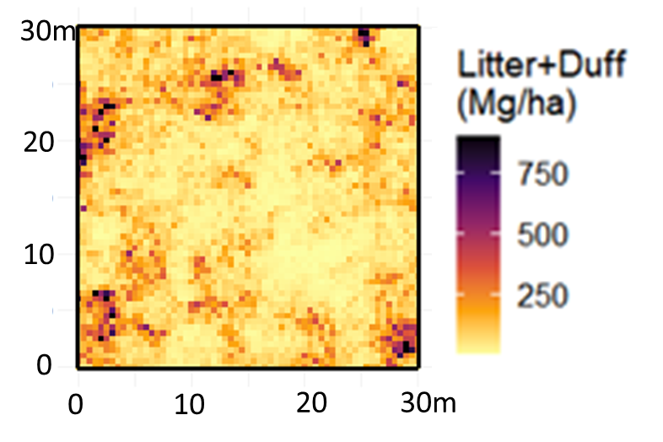
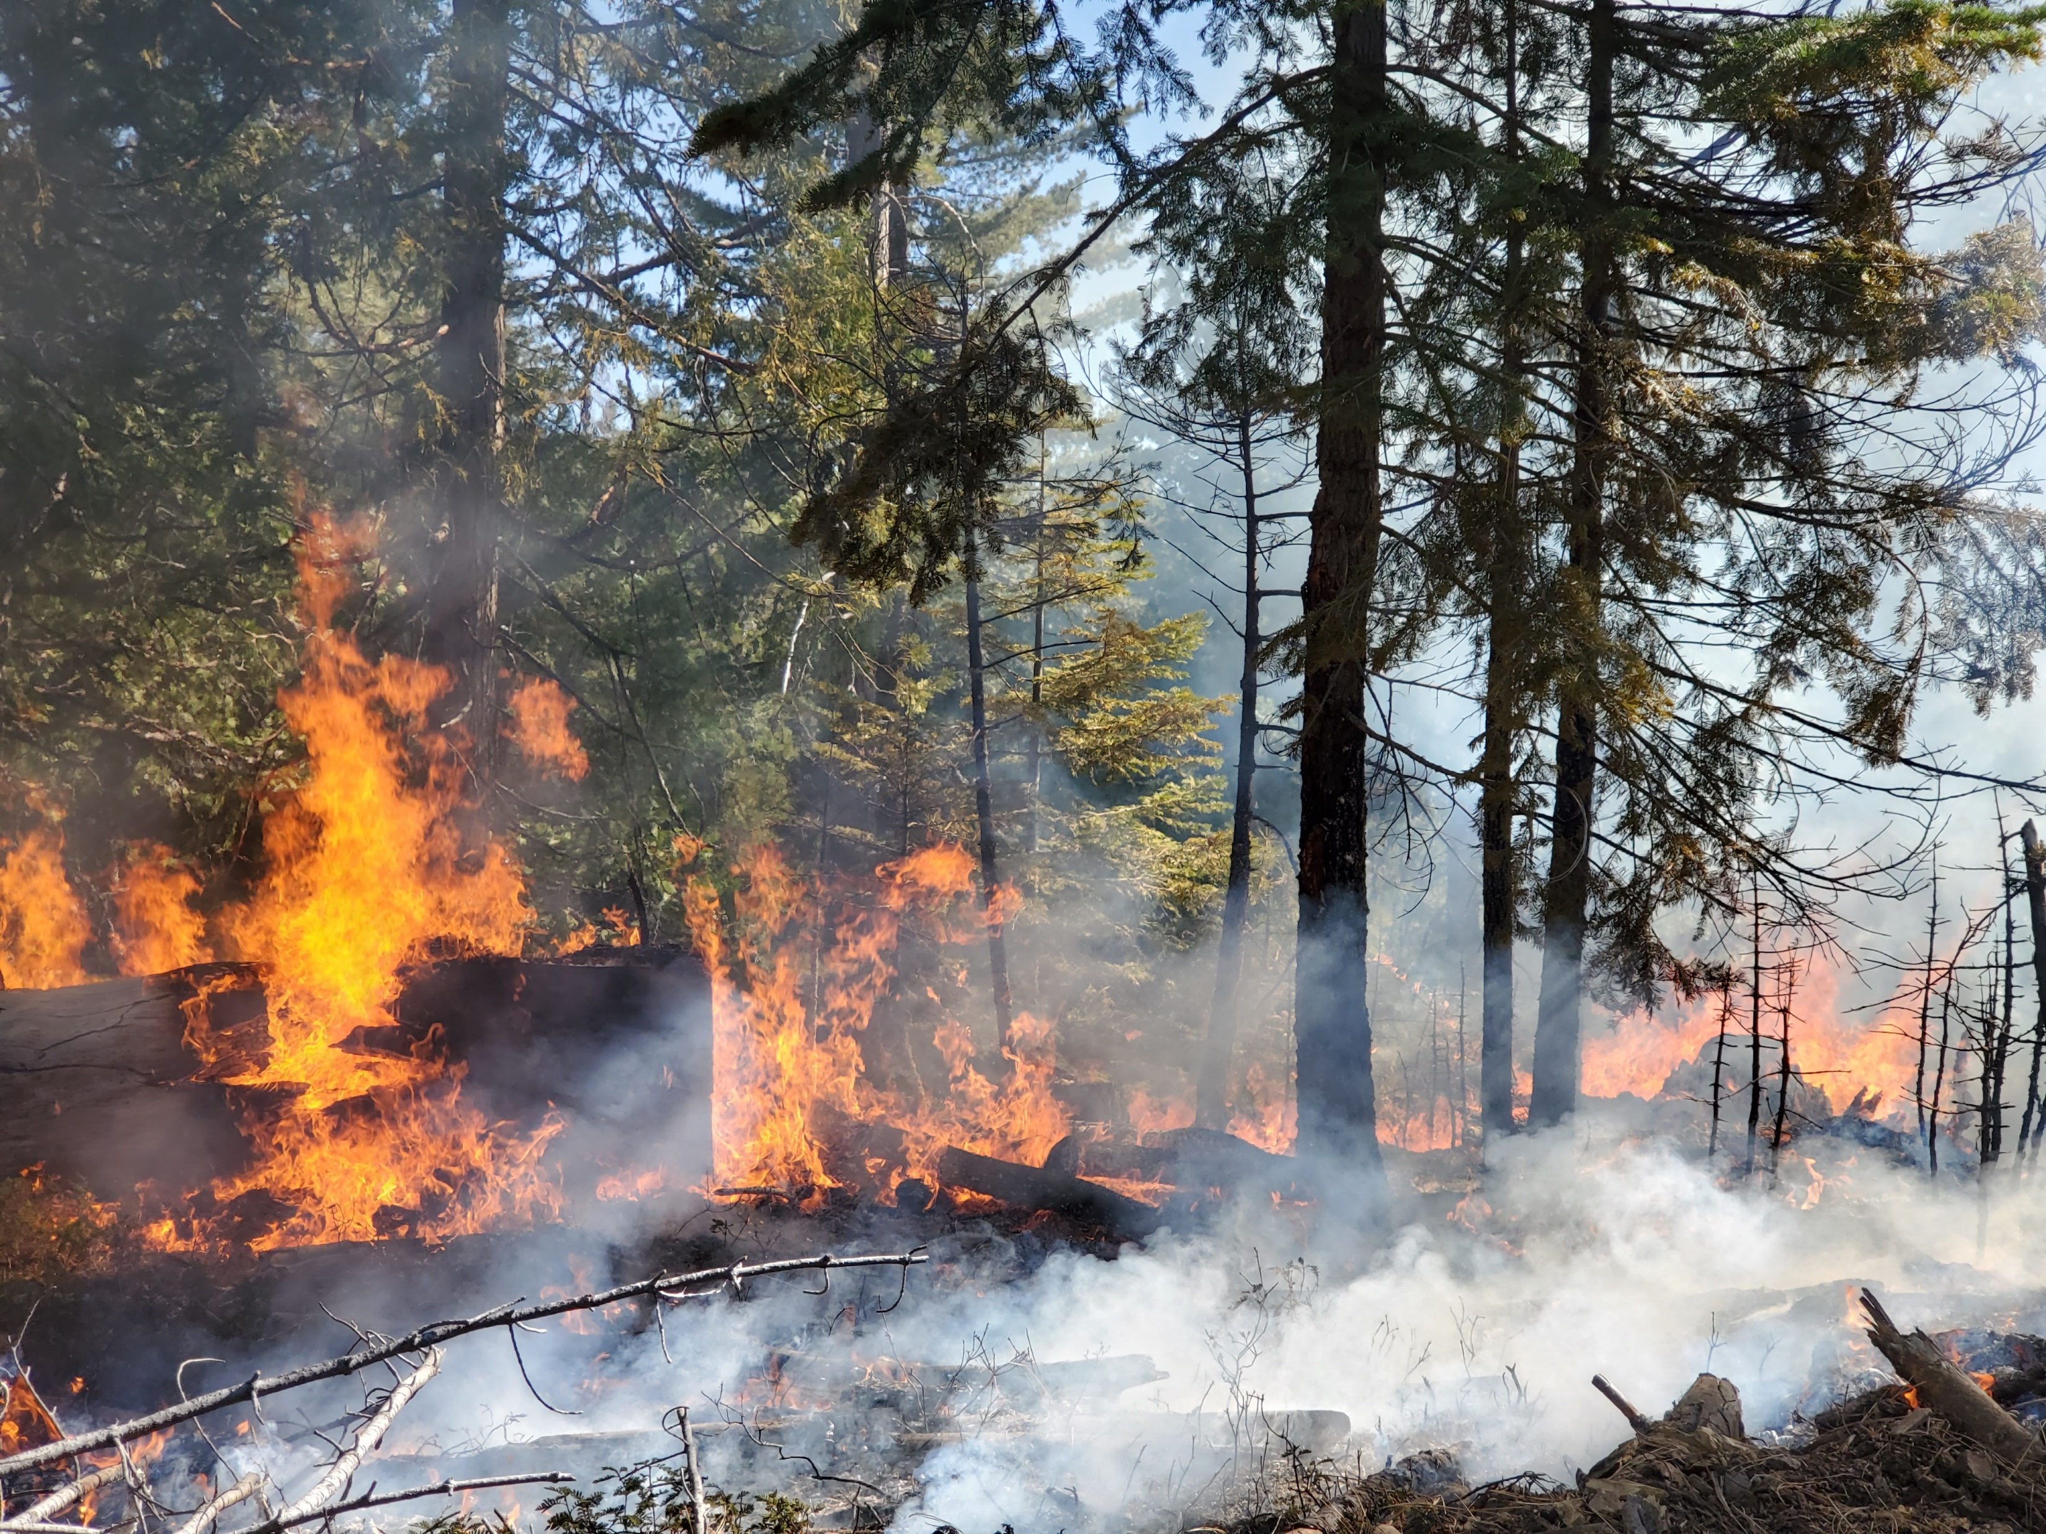
“Develop and employ a new fuel measurement and mapping system to resolve essential fuel components and spatial fuels heterogeneity at multiple scales.”
Project Narrative, GFO-18-301. “Wildfire: Assessing and Preparing for Risks and Climate Change”
Current models
Improved models
Within-pixel variability
Coarse woody debris
2 km
Jen Johnson
Notes:
Motivation for this work
Current models do a reasonable job with the difficult task of mapping fuel conditions across a landscape (left)
Two deficiencies associated with current fire/fuels models in this context at finer scales (middle)
Within pixel variability
No CWD / duff / smoldering combustiion
New models (right) need a way to measure / describe fine-scale spatial variation, including of CWD
Core goal is to be able to feed realistic fine-scale data into a CFD fire model (FIRETEC, Mark’s)

Slide 3
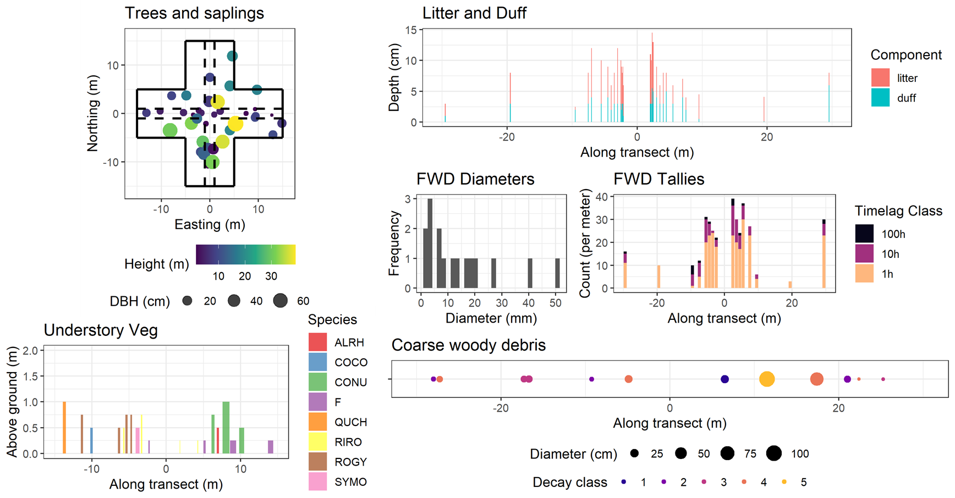
Notes:
Designed a sampling protocol which is a fairly standard forest / fuels inventory, but geared towards analysis of fine-scale spatial patterns
Top left: trees and saplings
Bottom left: understory veg
Top right: Litter and duff depths
Middle right: Tallies and diameters of fine woody debris
Bottom right: Inventory (with locations) of CWD

Slide 4
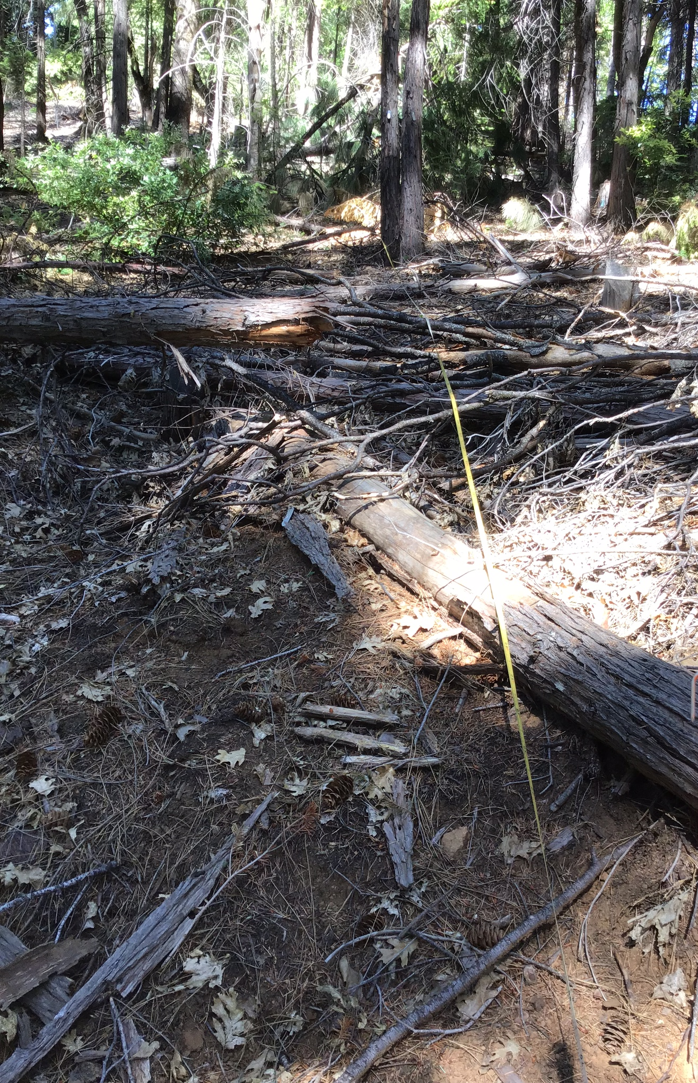
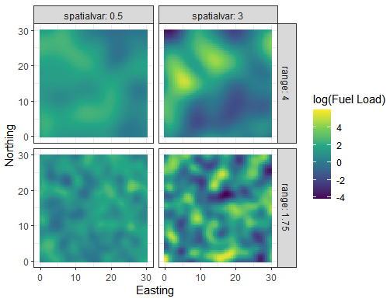
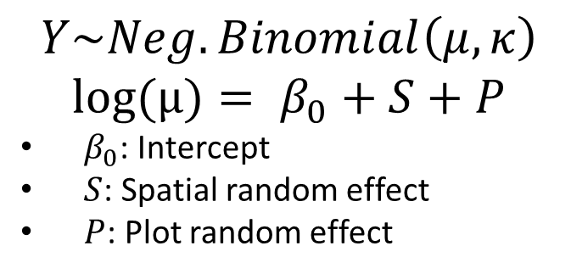
$$Y\sim Neg.Binomial\left(μ,κ\right)$$
$$\text{log}\text{(}μ)= β_{0}+S+P$$
$β_{0}$: Intercept
$S$: Spatial random effect
$P$: Plot random effect
Spatial Effect Magnitude
A
B
Spatial Effect Range
C
D
Hudson Northrup
Notes:
Use GLMMs with a gaussian process random effect representing fine-scale spatial autocorrelation
3 terms in the model
Advantages of a regression-based approach:
Models can easily handle incorporation of new fixed-effect covariates
By simulating from the model, we can turn sparse sampling into a continuous map of fuels
(right): gap & jackpot (patch with high fuel loads)
What are the spatial size and fuel loading magnitude of the patches and gaps?
GP ran eff allows quantitative description of the patch size (range) and the patch magnitude (spatial variance)
A: patches are large but weak
B: patches are large and strong
C: patches are small and weak
D: patches are small and strong

Slide 5
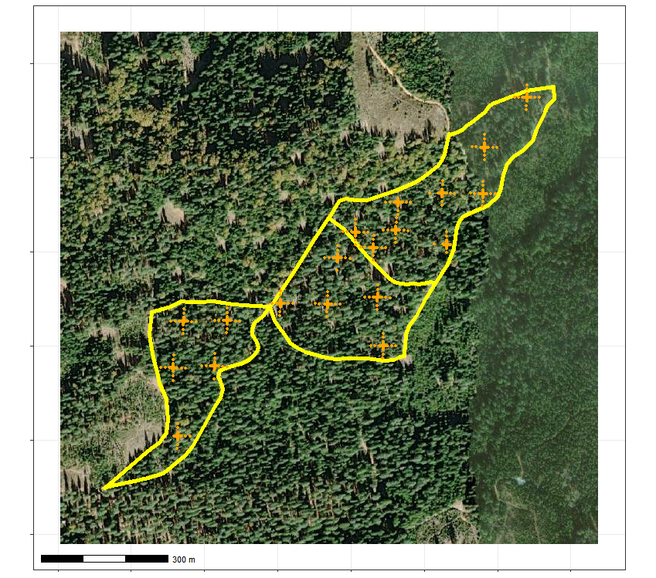
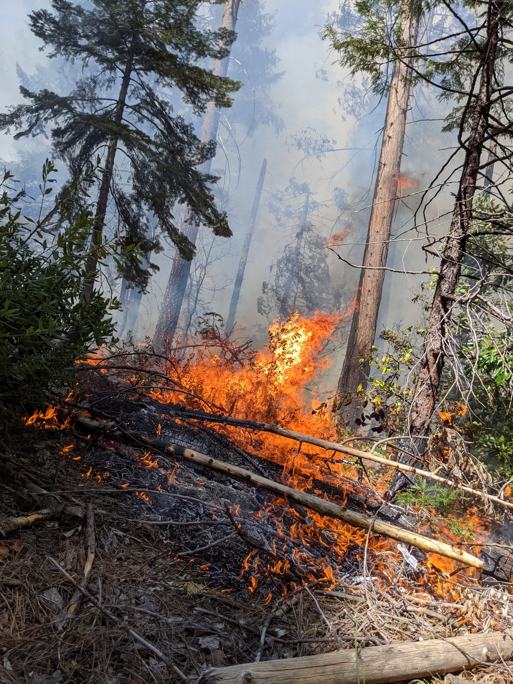
Study #1: Rx Fire
Stacey Frederick
Notes:
Left: 3 experimental units (6-9 ha each) sampled in summer 2020 (orange: dense subsamples)
Right: Burned them in spring 2021
Resampled in Summer 2021
Goals:
Pilot data collection and statistical analysis
Build fuel models for managed/unburned and managed/burned forest
Demonstrate application #1: Studying how fine-scale spatial pattern responds to experimental treatment (Rx fire)

Slide 6
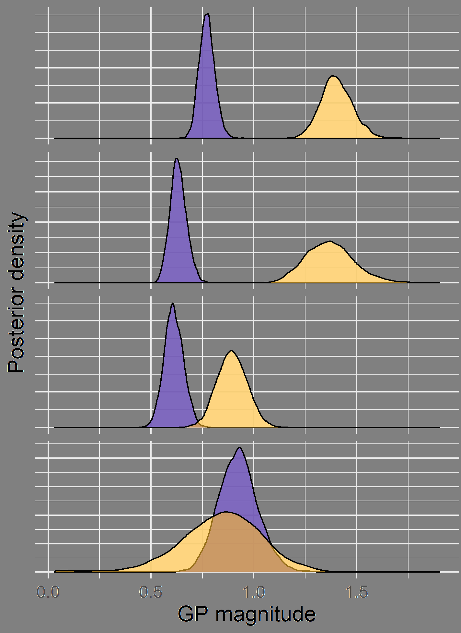
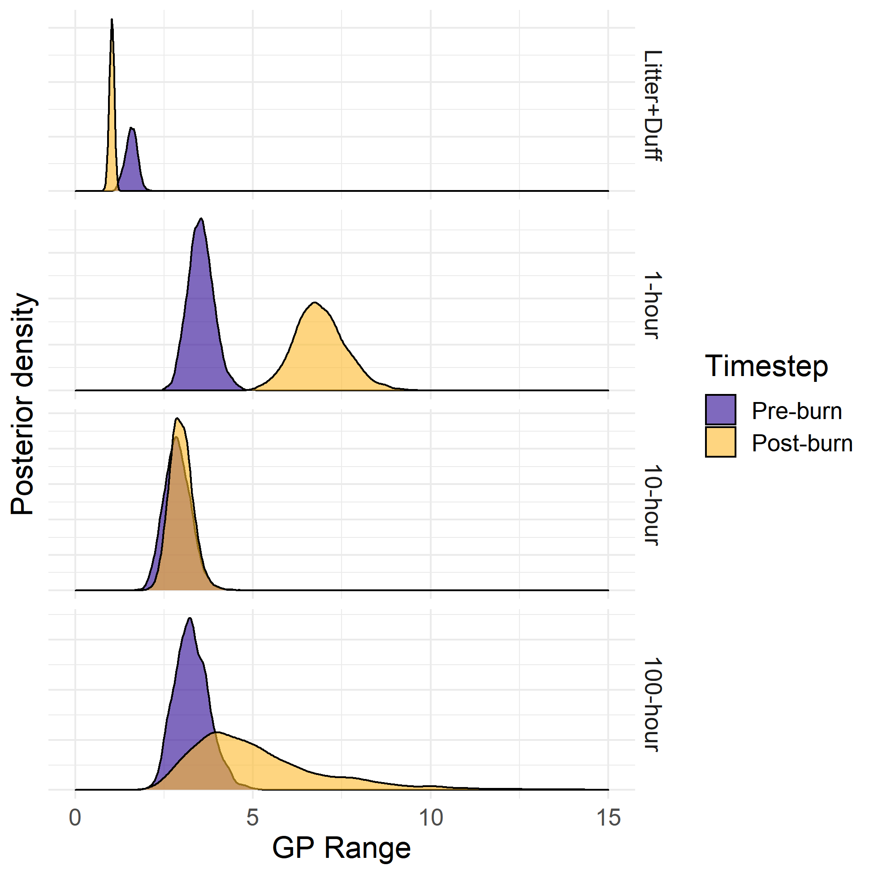
Study #1 Results
Notes:
They do (mostly)
Looking at: Posterior probability density on the y axis, parameter value on the x axis, panels for fuel component (rows) and GP parameter (columns). Parameter values for pre-burn (purple) and post-burn (yellow) data
Left: The Rx fire increased the magnitude of the GP effect for litter+duff, 1-hour, and 10-hour fuels, meaning that the spatial pattern was more intense postfire
Right: Rx fire decreased the range of autocorrelation for litter+duff, increased it for 1-hour fuels, didn’t affect 10-hour, and unclear results on 100-hour (post-burn probability distribution very similar to the prior, indicating that estimates for that parameter were not well informed by the data)

Slide 7
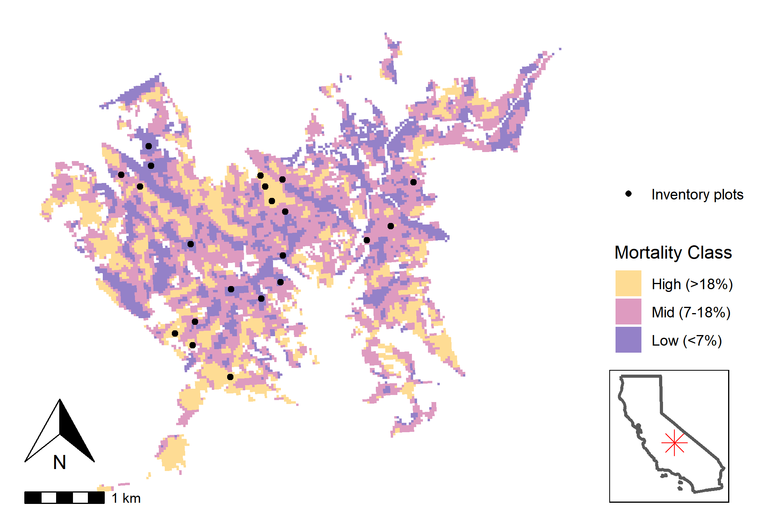
Study #2: Drought Mortality
Notes:
2nd study located in an area of SEKI with lots of mortality in the 2012-2016 drought
Two goals:
Understand how varying levels of drought mortality affected parameters of surface fuels (mean loading, coarse scale variability, fine-scale autocorrelation)
Build and test the pipeline for simulating continuous fuelbeds of all 7 fuel components (duff, litter, FWD, CWD, understory veg, saplings, trees)

Slide 8
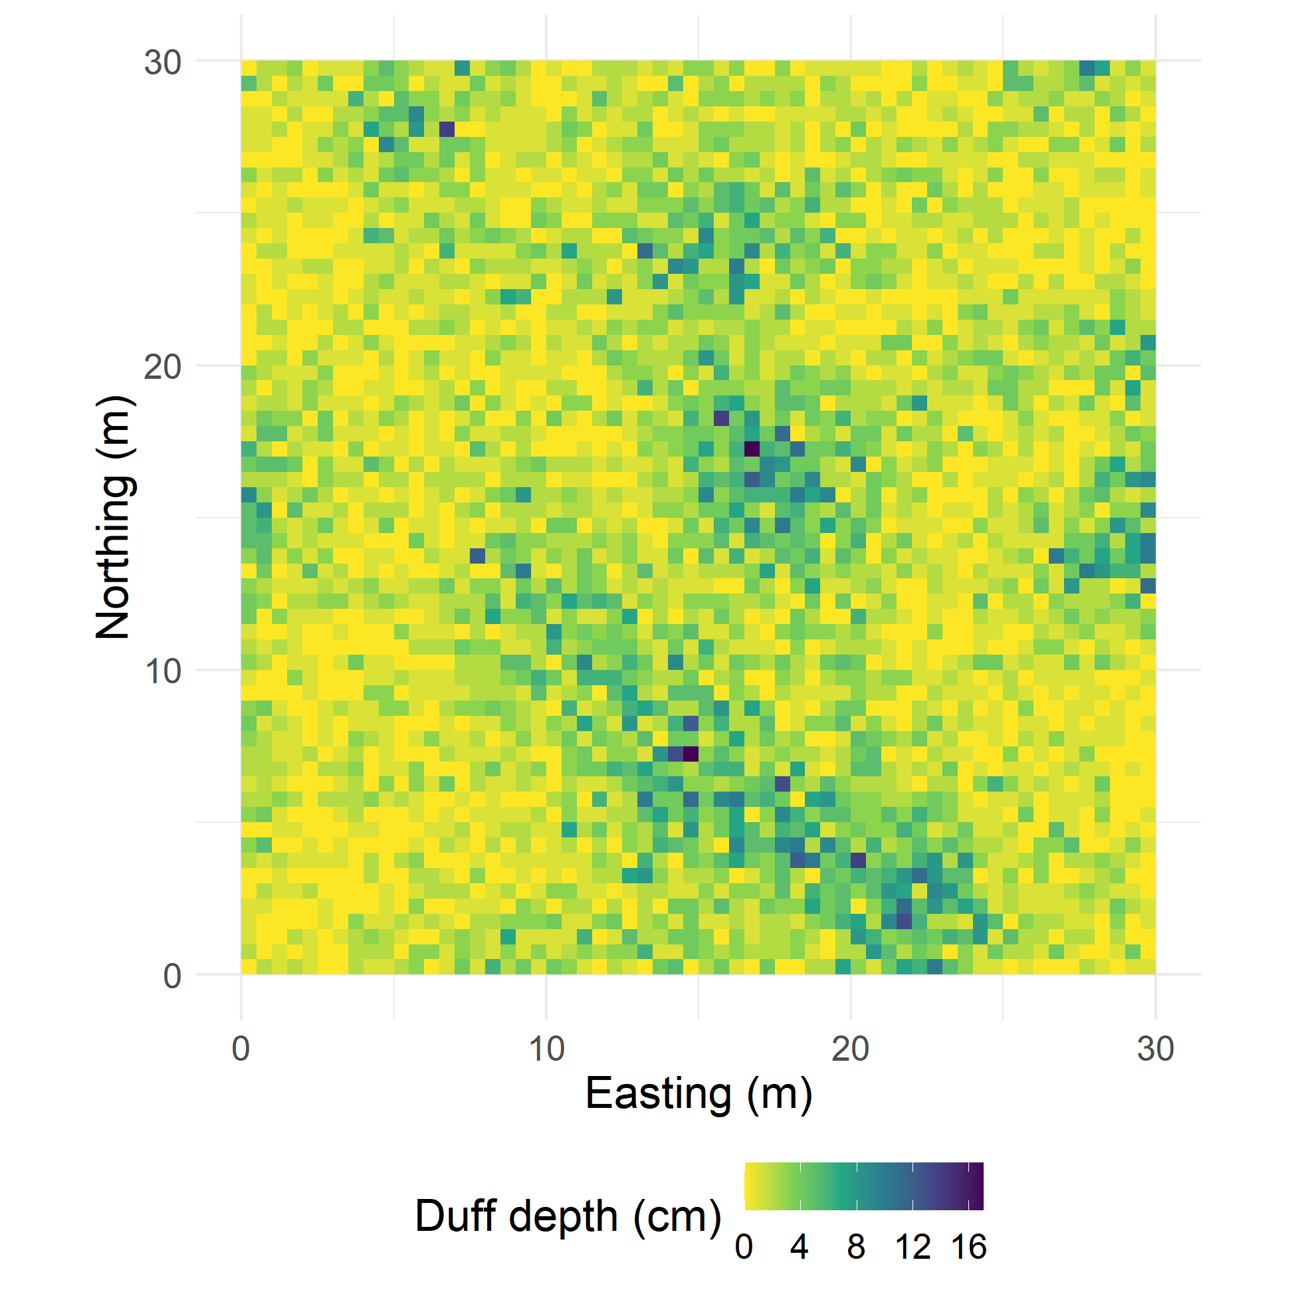
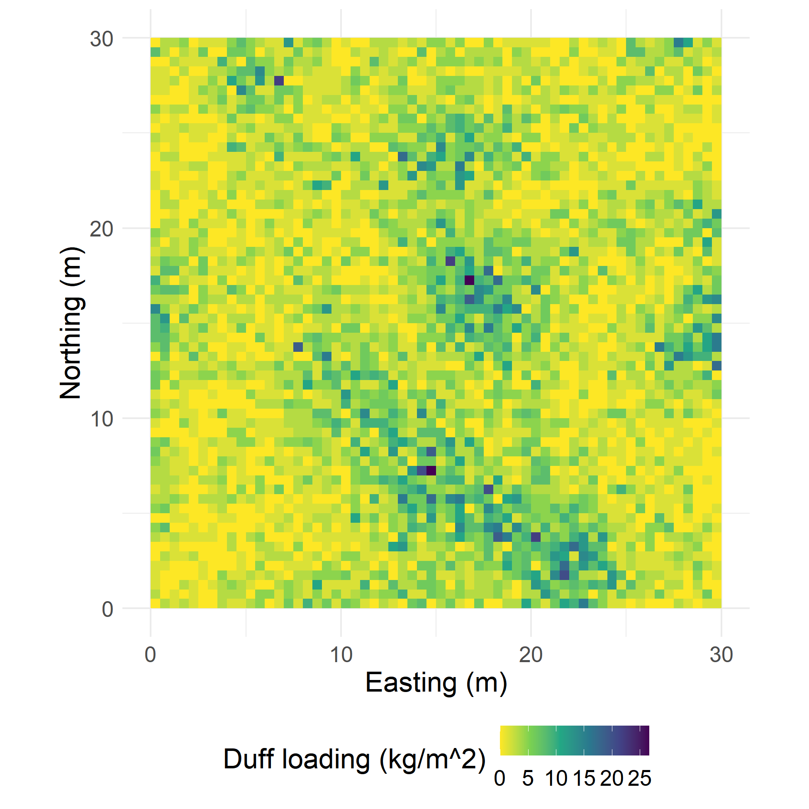
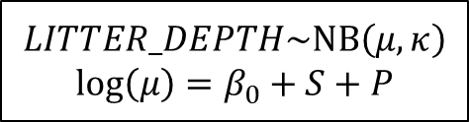
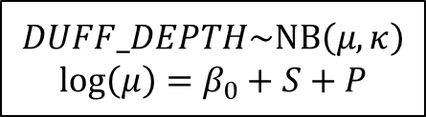
Duff and litter
Estimate parameters for GLMM
Simulate depths on continuous grid
Allometric equations convert from depth to biomass
$$DUFF_DEPTH\sim \text{NB}\left(μ,κ\right)$$
$$\text{log}\left(μ\right)=β_{0}+S+P$$
$$LITTER_DEPTH\sim \text{NB}\left(μ,κ\right)$$
$$\text{log}\left(μ\right)=β_{0}+S+P$$
Notes:
For all of these models, each plot is assigned a group (e.g. low / medium / high drought mortality) and each group gets its own set of GLMM parameters
Flexible definition of group: Could classify based on the observed data, remote sensing, disturbance history, etc.
1: Using the observed data, estimate the parameters for GLMMs for duff and litter depth (review b0, S, P), with parameters varying by group
2: Using the estimated parameters, simulate duff / litter depths on a continuous grid
3: Use allometric equations to convert from depth to biomass
Works for 1d application too

Slide 9
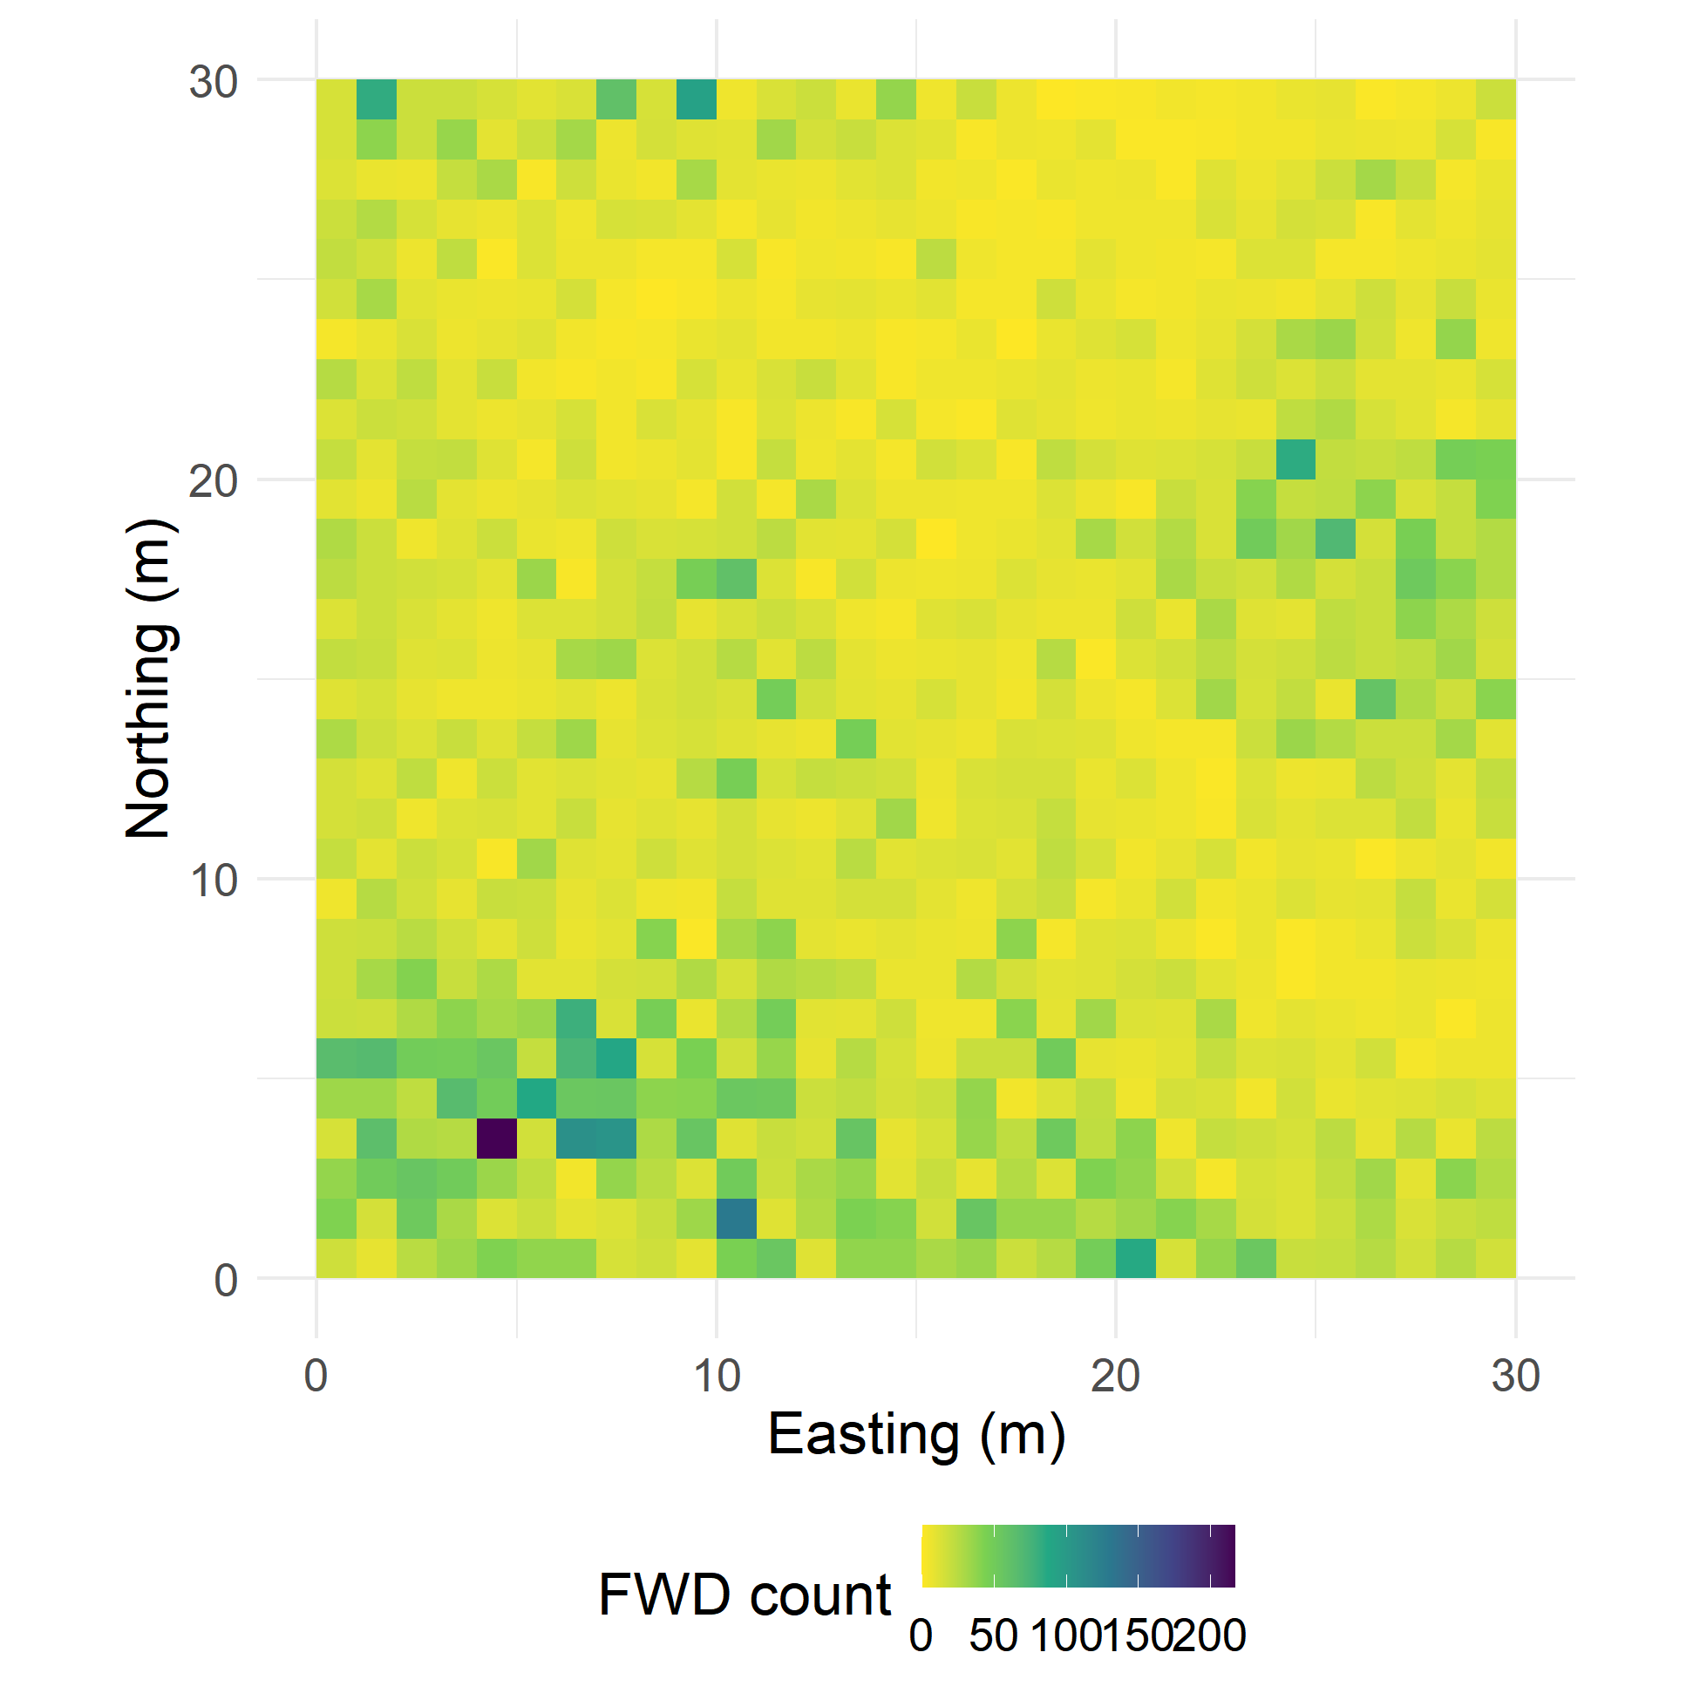
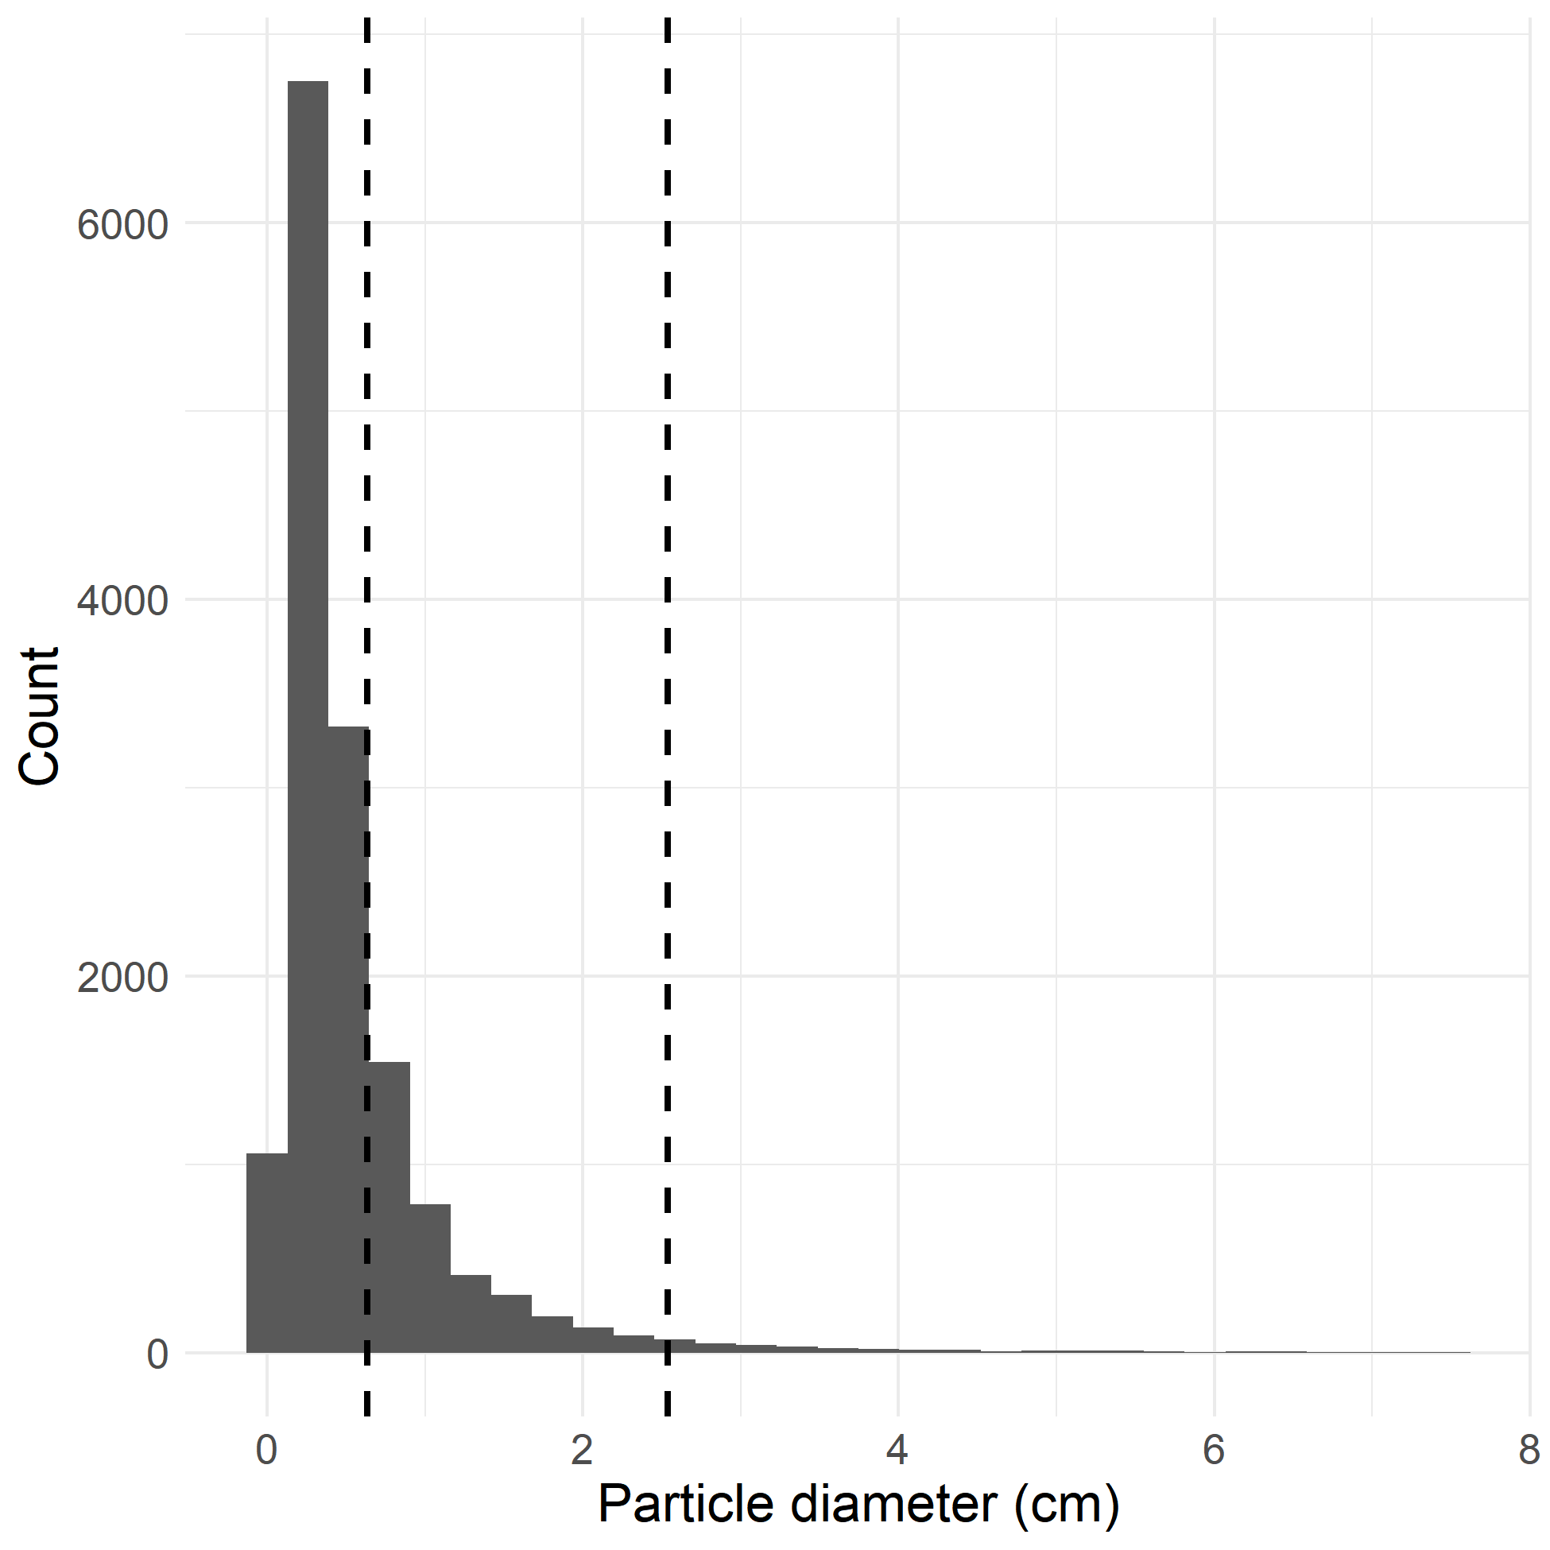
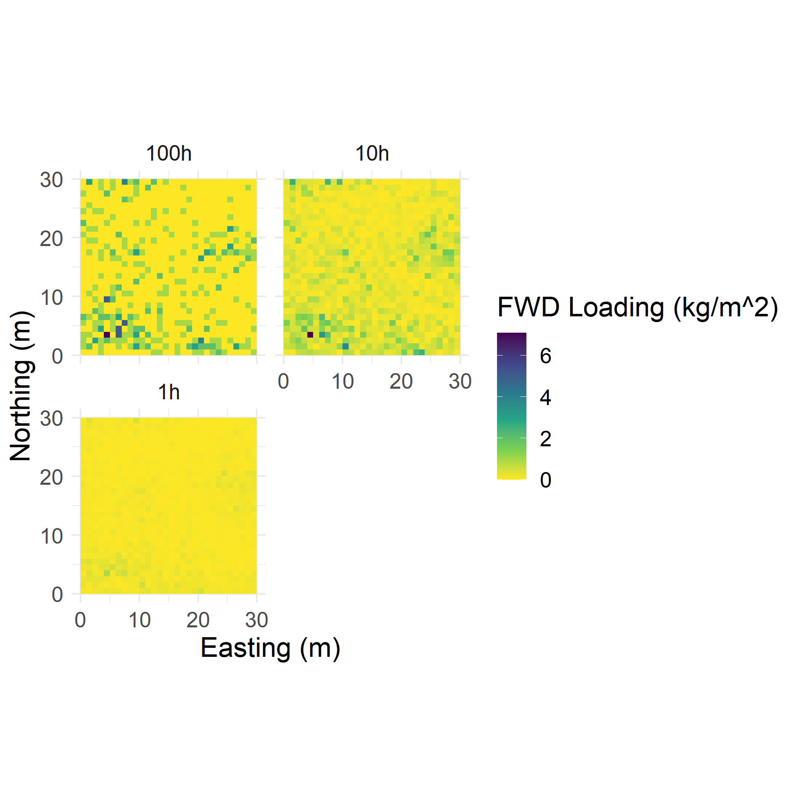
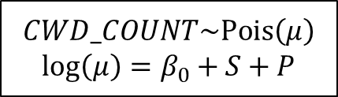

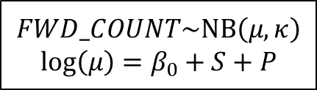

Fine woody debris and coarse woody debris
Estimate parameters for GLMMs
Simulate counts on continuous grid
Aggregate by size class and convert to biomass
Simulate diameter for each particle
$$FWD_COUNT\sim \text{NB}\left(μ,κ\right)$$
$$\text{log}\left(μ\right)=β_{0}+S+P$$
$$FWD_DIAM\sim \text{Inv}\text{.}\text{Gamma}\left(α,β\right)$$
$$CWD_COUNT\sim \text{Pois}\left(μ\right)$$
$$\text{log}\left(μ\right)=β_{0}+S+P$$
$$CWD_DIAM\sim \text{Inv}\text{.}\text{Gamma}\left(α,β\right)$$
Notes:
FWD and CWD both have 2 part models. FWD is shown, but the setup is the same for CWD.
In the first part, there’s a spatial GLMM (very similar to litter/duff GLMM) for the count of particles on a 1m subtransect
In the second part, there’s an aspatial GLMM fit on the diameters of individual particles
Simulation of continuous fuelbeds has 3 steps:
Simulate counts on a continuous grid
For each simulated particle, simulate a diameter
Aggregate the particles by size class (size classes are flexible!) and use allometric equations to convert to biomass

Slide 10
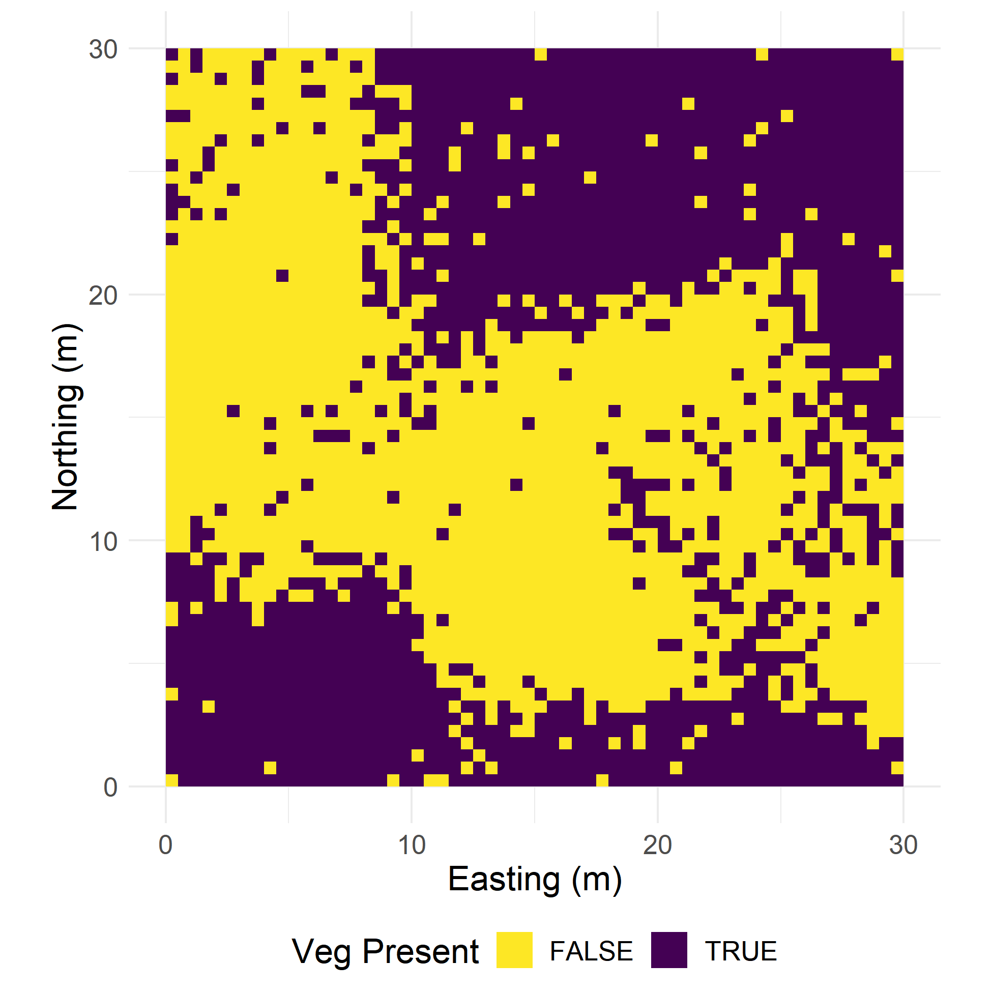
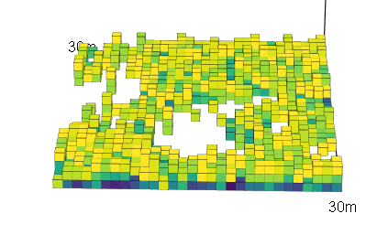
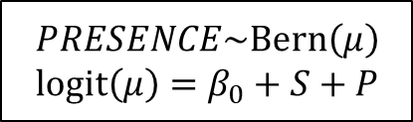
Understory vegetation
Estimate parameters for GLMM
Simulate presences on continuous grid
Distribute biomass into voxels
Draw pixel characteristics from observed data
Species | Height (m) | Cover (%)
CECO | 1.25 | 40
ABCO | 0.50 | 15
… | … | …
$$PRESENCE\sim \text{Bern}\left(μ\right)$$
$$\text{logit}\left(μ\right)=β_{0}+S+P$$
Notes:
The statistical model for understory veg is a spatial GLMM predicting shrub presence
To simulate continuous fuelbed:
Simulate presences on a continuous grid
For each pixel with a presence, draw individual characteristics (species, height) from the observed data, weighting by the observed abundance of that species/height combo
Use allometric equations to predict the crown biomass on each pixel, distribute that biomass into voxels based on the height in that pixel

Slide 11
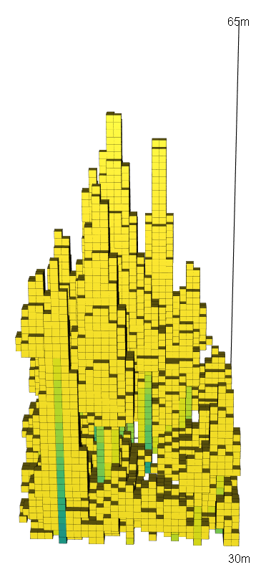
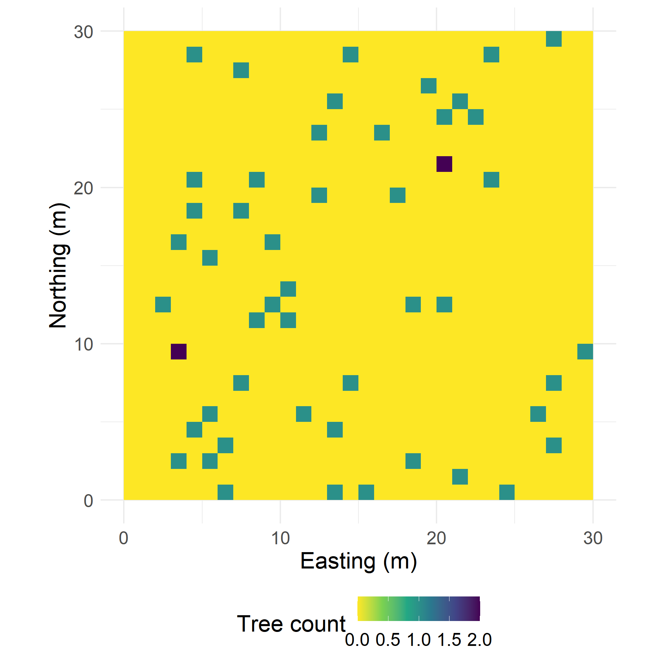
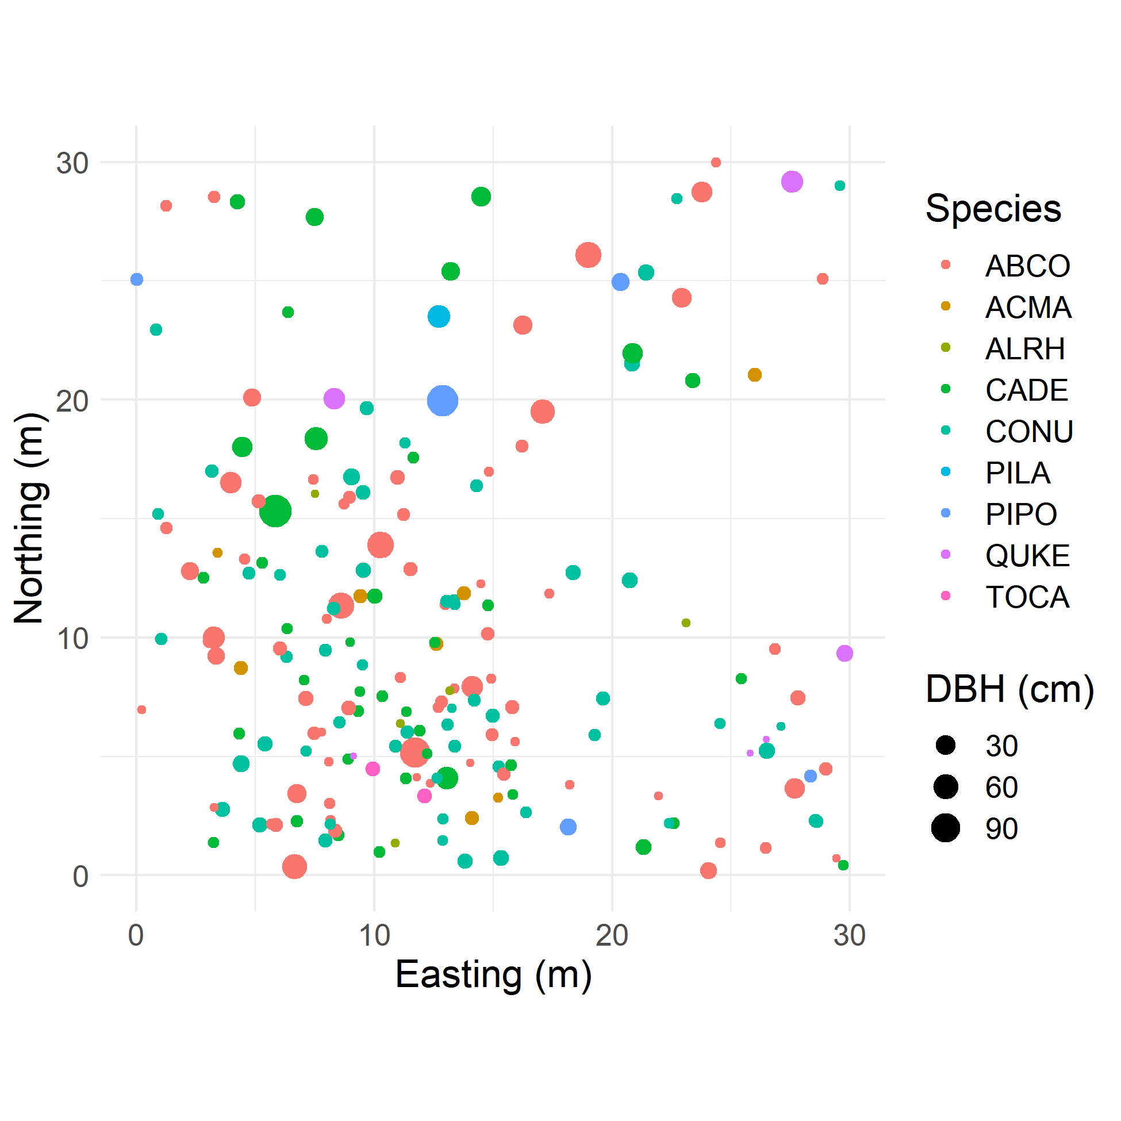
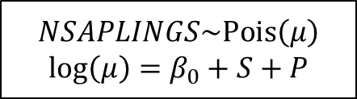
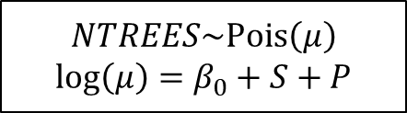
Trees and saplings
Estimate parameters for GLMMs
Simulate presences on continuous grid
Distribute biomass into voxels
Draw stem characteristics from observed data
$$NTREES\sim \text{Pois}\left(μ\right)$$
$$\text{log}\left(μ\right)=β_{0}+S+P$$
$$NSAPLINGS\sim \text{Pois}\left(μ\right)$$
$$\text{log}\left(μ\right)=β_{0}+S+P$$
Notes:
Trees and saplings were observed and modeled separately, though with identical models
Spatial GLMM with poisson response for number of trees/saplings within a 1m2 quadrat
After simulating parameters, simulate a count of stems on a continuous grid
Draw individual characteristics (species, DBH, height, HTCB) from the treelist for the current group; fuzz the continuous grid coords to make a stem map
Assume conical crowns and boles, estimate bole and crown biomass, distribute biomass into voxels

Slide 12
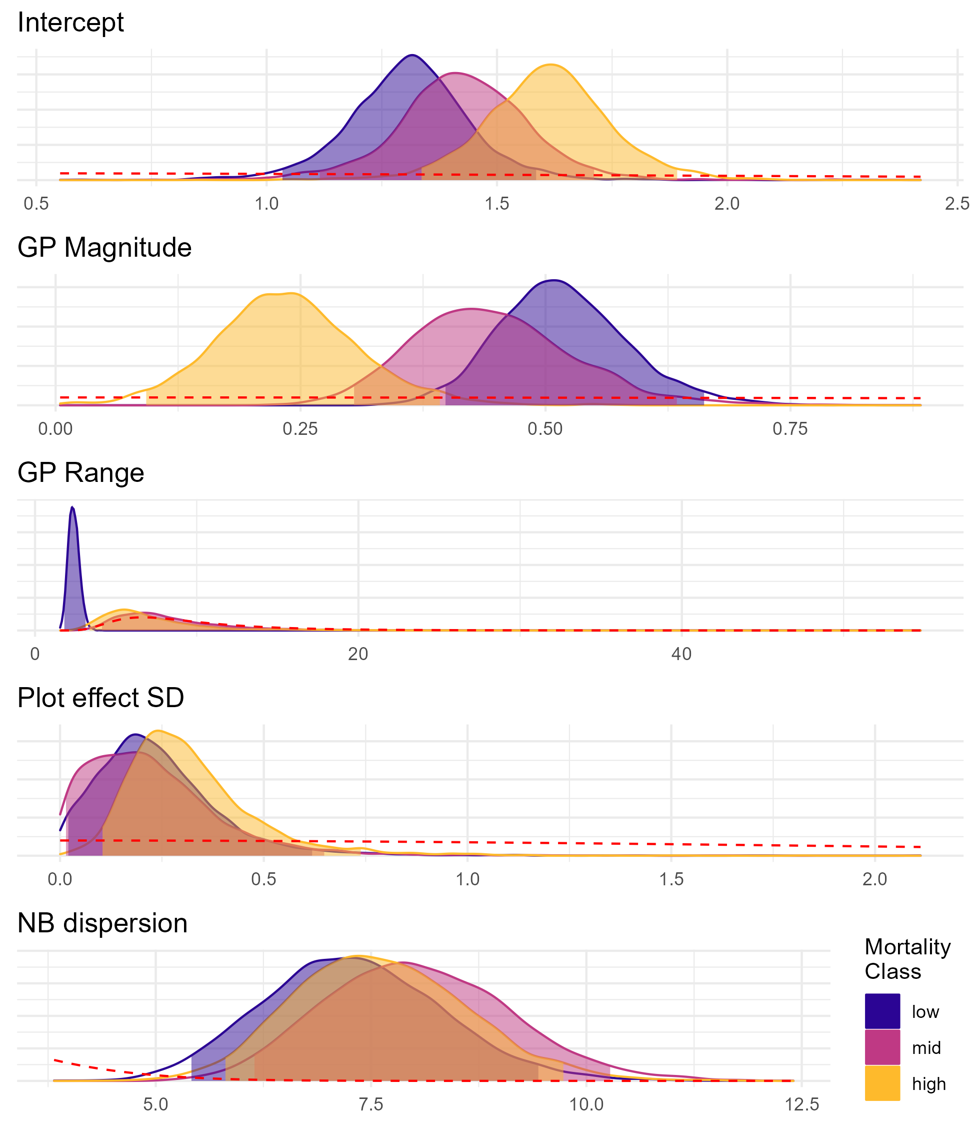
Study #2 Results
Describe and implement data collection / analysis / data products pipeline
Evaluate performance of 9 GLMMs (in-bag prediction, out-of-bag prediction, plot-level simulations)
Few differences across drought mortality levels
More data needed to describe spatial pattern of rare events (CWD, trees, saplings)
Litter Posterior Distributions

Slide 13
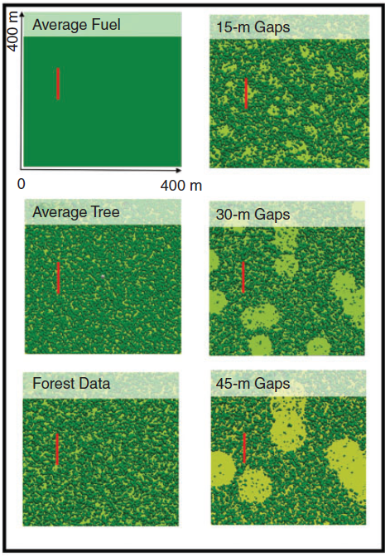
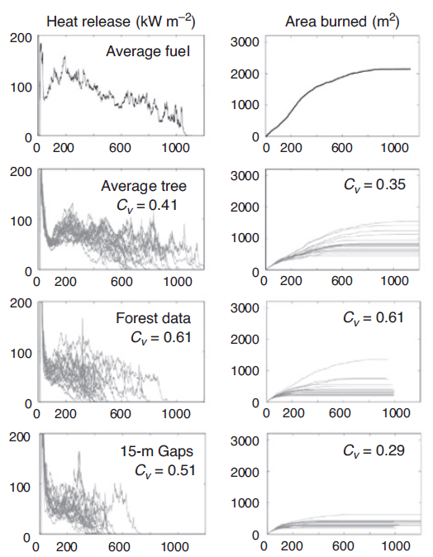
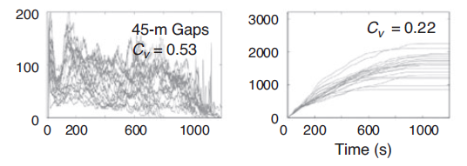
Next Steps
Large-scale SEKI sampling by USGS / NPS
Feed simulations into a CFD fire model to evaluate effects of varying spatial parameters on fire behavior
Atchley et al. (2021)

Slide 14
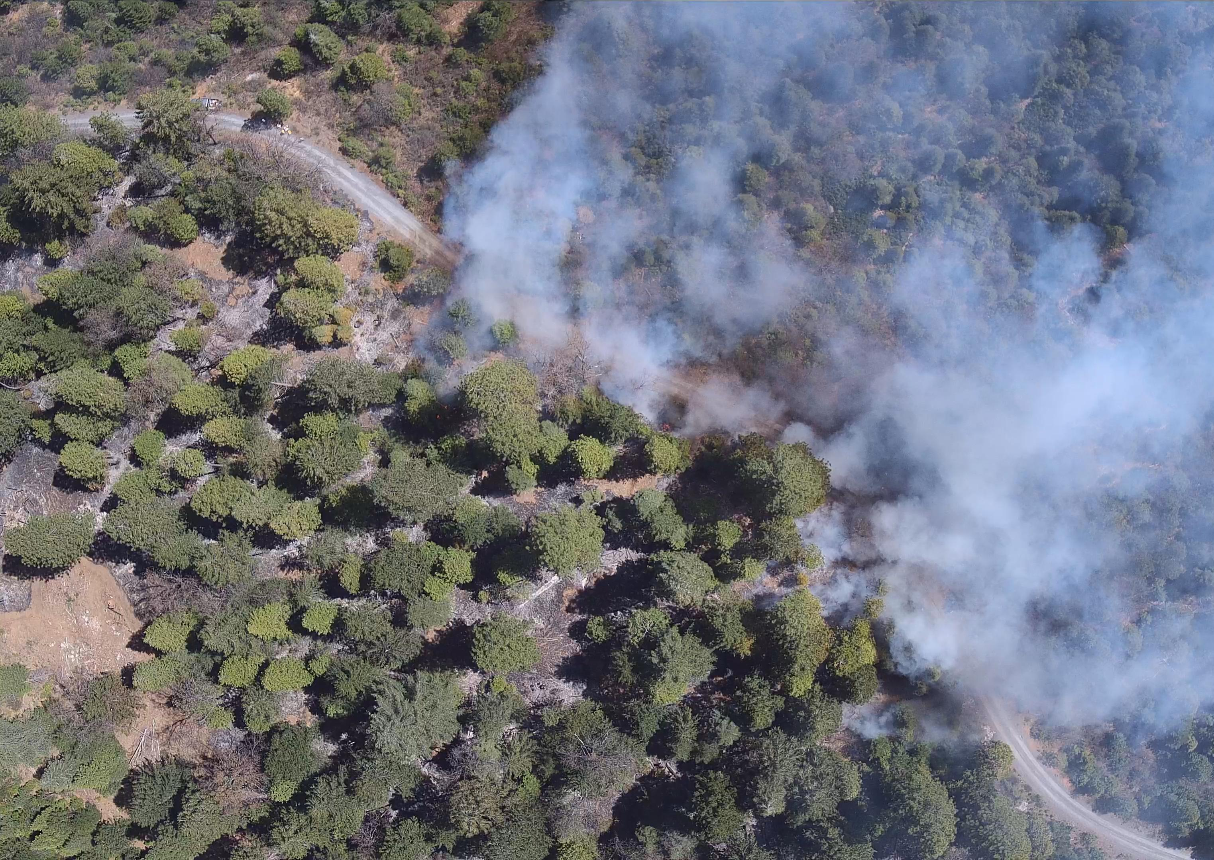
Acknowledgements
Data collection: Hudson Northrup, Ian Moore, Angie Notari, Gavin Williams
Statistical advice & coding assistance: Lisa Rosenthal
Dissertation Committee: John Battles, Scott Stephens, Perry de Valpine
Pyregence WG2 & TAC
Rx Fire: Rob York, Ariel Roughton, BFRS Staff & Volunteers

